Slide 1
Quadruped Robot for Agricultural Research
Team: Austin Neff, Kevin Nelson, Jordan Raver, Ben Siesser, Sam Spencer, Yang Yang
Team Advisors: Shad Roundy, Kam Leang

Slide 2
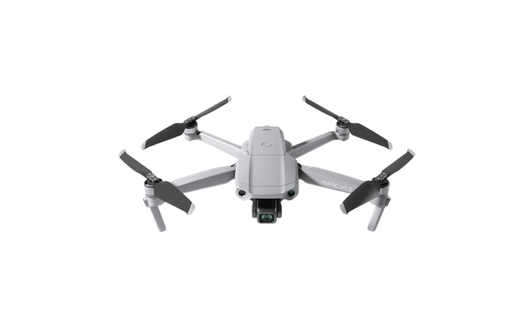
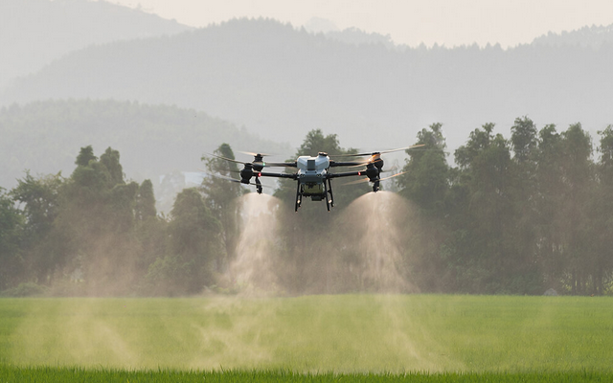
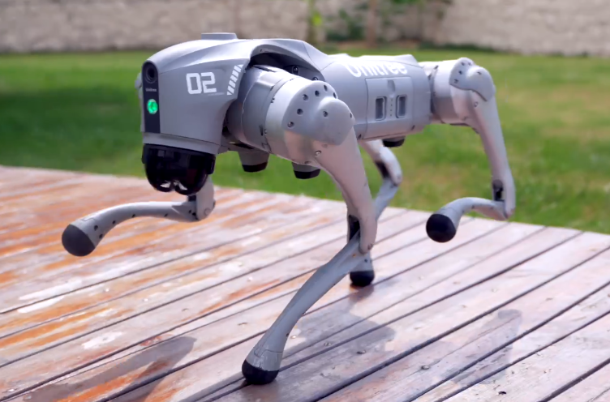
Project Background
In agriculture, autonomous quadcopters are the go-to solution for field surveying
However, they cannot land or modify the terrain, limiting their usefulness
An affordable quadruped could fill in these gaps
Notes:
In agriculture, autonomous quadcopters are the go-to solution for field surveying
However, these quadcopters are limited in what they can measure or modify due to their inability to land or dig
Consequently, a land vehicle is needed to fill in these gaps
Tracked vehicles cannot maneuver over and around sensitive crops without damaging them, so a quadruped is needed
Current quadruped options are some combination of expensive and locked down, so we need an alternative

Slide 3
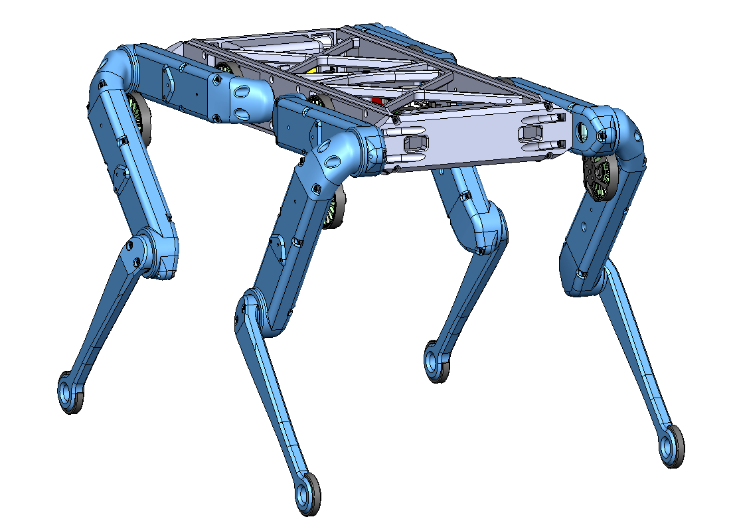
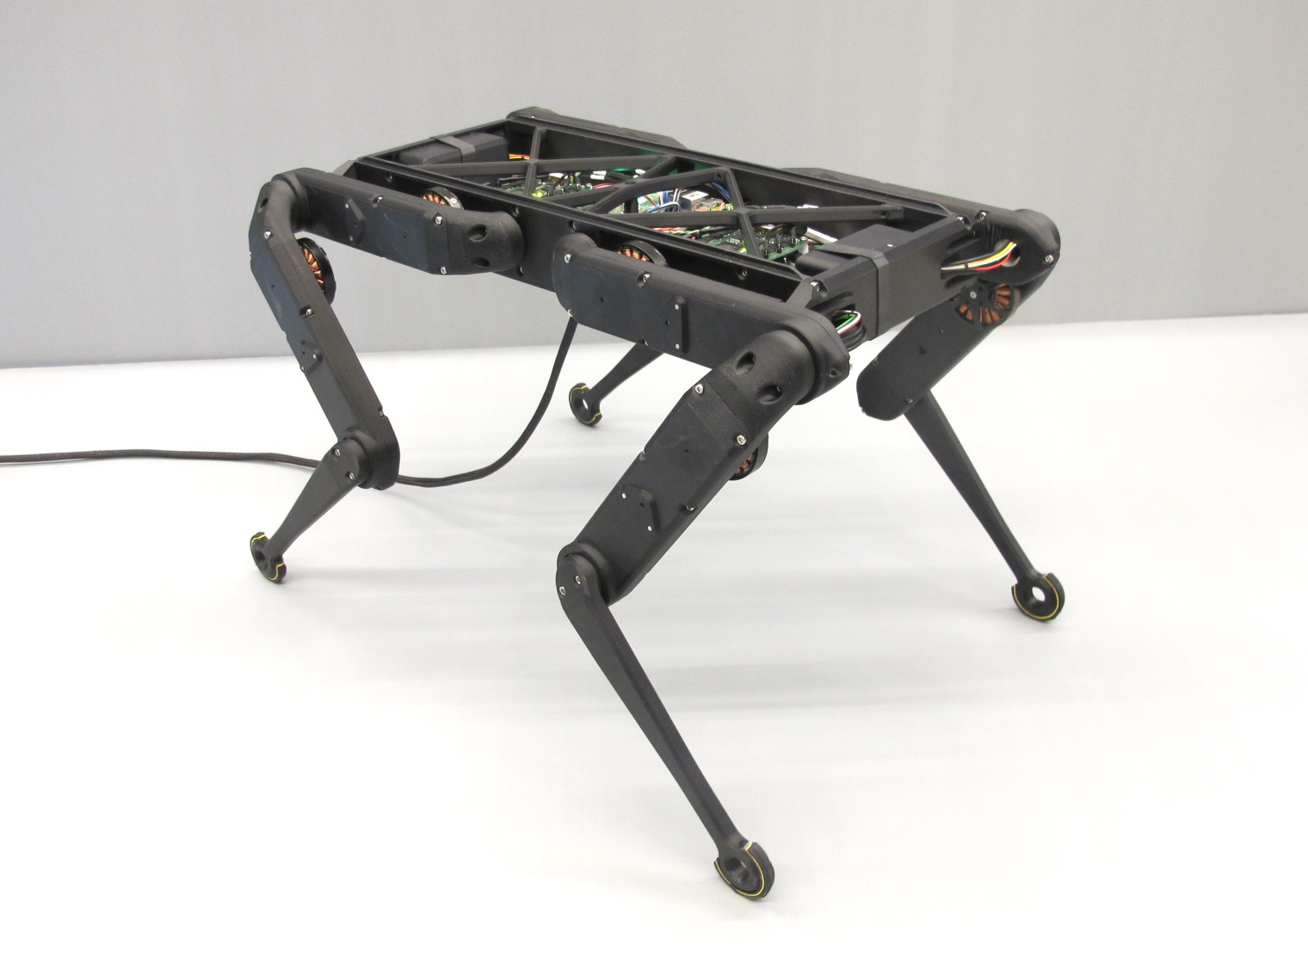
Project Objective
The objective of the project is to construct a quadruped robot. The Open Dynamic Robot Initiative will be used as guidance. The robot is intended as a cheaper and more open alternative for robot smart agriculture than what is currently available in professors Roundy and Leang’s laboratories.

Slide 4
Milestone Overview
Design Review One
Foundational code
Initial body assembly
First leg complete mounted
Midterm Review
All legs complete and mounted
Body enclosure complete
Basic quadruped motion
Design Review Two
Fully wireless control
Meets overall runtime expectations
Full walking capability
Basic navigation systems
Final Report
Advanced navigation algorithms

Slide 5
Milestones and Tasks Status
Number of design review 1 milestones met: 3/3
Number of design review 1 tasks met: 13/13
Number of ME EN 4010 milestones met: 3/11
Number of ME EN 4010 tasks met: 15/35

Slide 6
Milestone 1 - Software
Milestone
Foundational control code complete and to command ODrive controller boards while being able to receive information from the IMU
Metric of Success
Command capability
Sensor reading
Able to switch modes
load movement ramps for an arbitrary number of legs
Result
Individual nodes capable of sensor reading, filtering, and controlling a leg segment
Nodes able to communicate with one another
Future
Developing primitives for quadruped motion
Implement systems to alter primitives due to IMU readings

Slide 7
Milestone 2 - Body
Milestone
Majority of robot body complete including eight control board mounting brackets, two battery mounts, and printed leg components for eight legs
Metric of Success
More than 90% of components mounted
Result
All body components printed and mounted except IMU (95% of components mounted)
Power wiring complete
Future
Finish wiring CAN and power lines
Attach top cover following full untethering

Slide 8
Milestone 3 - Legs
Milestone
Two leg segments complete and mounted for initial single leg testing
Metric of Success
At least 2 actuator modules built (1 full leg)
Result
All 8 actuator shells printed
Two legs fully assembled
One leg fully wired and mounted
Future
Assemble, mount, and wire remaining legs
Test synchronous leg movement
Single leg moves (both actuators move simultaneously)

Slide 9
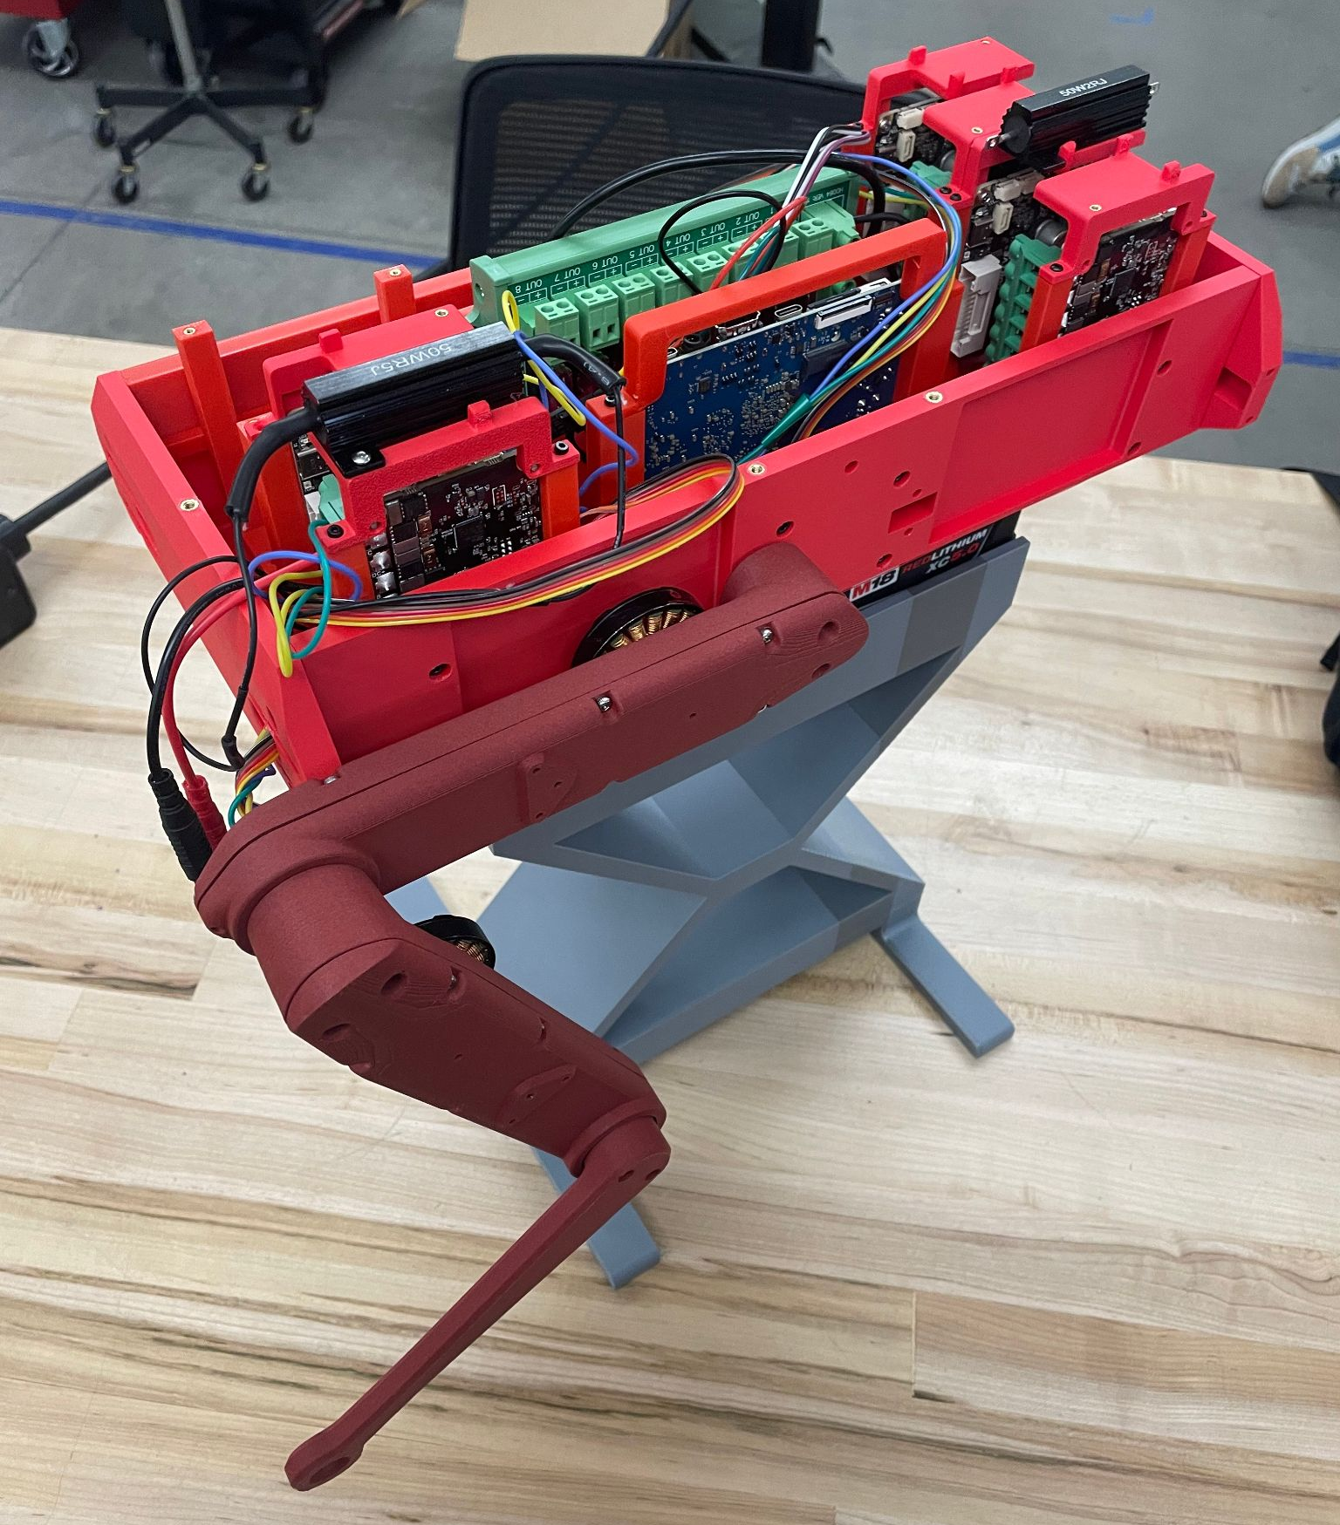
Tasks to Do
Future Tasks
Developing primitives for quadruped motion
Implement systems to alter primitives due to IMU readings
Finish wiring CAN and power lines
Attach top cover
Verify internal temperatures, implement cooling system if necessary
Assemble, mount, and wire remaining legs
Test synchronous leg movement

Slide 10
Plan for Midterm Prototype
Milestone
All 4 legs mounted and wired
Body complete and enclosed with a lid printed in CF-PLA
Basic Motion achieved
Metric of Success
All eight actuator modules completed and moving freely
100% of components mounted and wired
Six directions of motion available via primitives
Currently:
Two legs completed (one mounted)
Body mostly finished without a lid
foundational code implemented

Slide 11
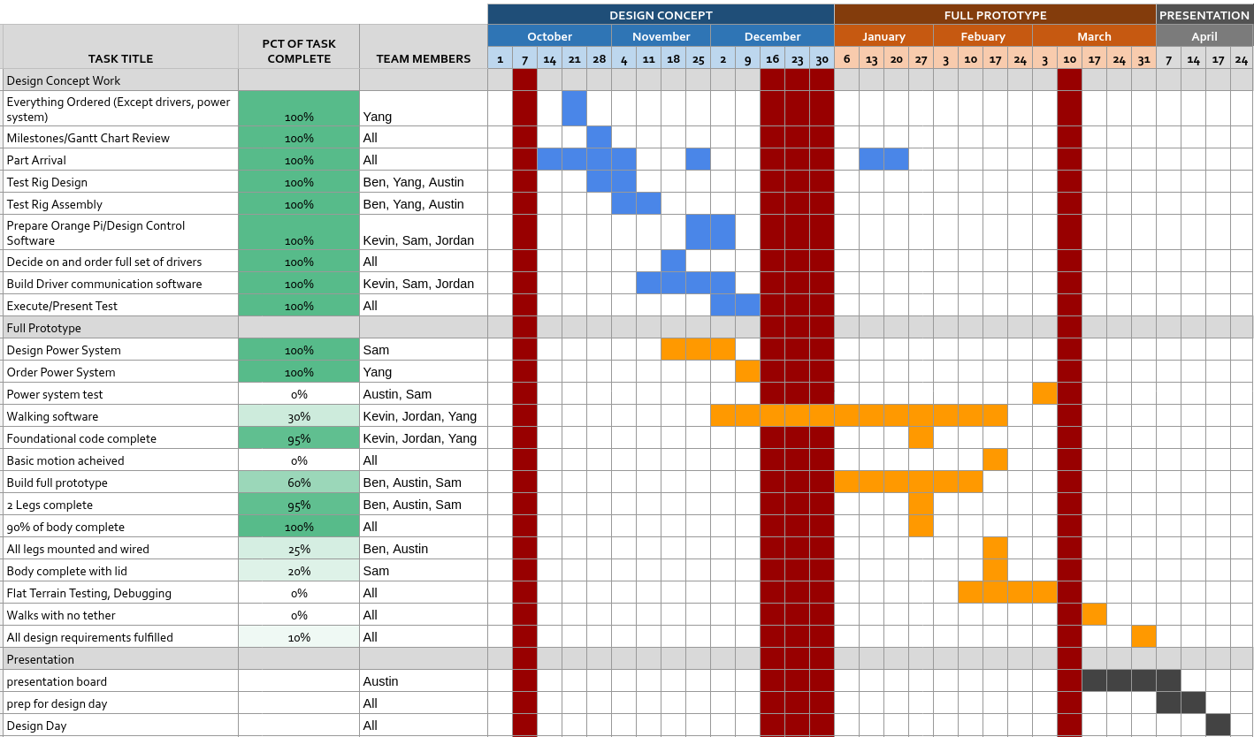
Project Management - Plans

Slide 12
Budget Update
Total Budget Available: $6000
Remaining: $1923.68
Total Ordering Information from Purchasing Request Sites
Vendor | Date | Subtotal
PWB Encoders | 9/21 | $1,245.77
Amazon | 9/28 | $134.74
Amazon | 9/30 | $9.99
123 Bearing | 9/30 | $382.61
Belting Online | 9/30 | $202.61
McMaster-Carr | 9/30 | $76.10
Amazon | 9/30 | $7.99
Digikey (Returned) | 9/30 | $14.49
Amazon | 10/10 | $127.99
ODrive | 10/21 | $156.61
Bambu Lab | 10/21 | $69.98
Adafruit | 10/21 | $21.33
Digikey | 10/21 | $93.15
Amazon | 10/21 | $119.80
Amazon | 11/11 | $19.98
ODrive | 11/11 | 1,050.61
Amazon | 12/3 | $315.03
Amazon | 1/26 | $13.56
Amazon | 1/28 | $13.98
As of 1/26 | Total (+tax&ship): | $4,076.32
Projected Usage:
$300 for sensors
$500 for backup parts

Slide 13
Team Member Contributions
Austin
Worked on presentation and assignment making
Helped with assembly
Communication with advisors
Ben
Led leg assembly
Led 3D printing
Sam
Led body design
Led mounting hardware
Batteries
Kevin
Led the leg control code and inverse kinematic implementation
Set up wireless control of robot
Jordan
Communication with advisors
Worked on leg control code and inverse kinematic
Yang
Led part ordering & maintaining BOM
Worked on IMU control code

Slide 14
Other Concerns
Robot Weight
The torque output at one joint measured last semester was 0.714 Nm at 5 A
With the battery system, we can run the motors at 15 A
This suggests a peak torque of 2.142 Nm, which corresponds to 3 pounds of weight in the highest load configuration per joint
This should be plenty to lift a 10 pound robot

Slide 15
Questions?

